Slide 1
Time Series Forecasting

Slide 2
Time Series
Time series: A series of observations on a variable, recorded after successive equal intervals of time (e.g. every year, every quarter, every month, etc)
Bivariate data: Time and the actual variable under observation
Example: Gold prices year-on-year
Objectives
Study past behaviour of the data
Make future predictions
Date | Gold Price (Per Ounce)
01-01-1970 | $35.2
01-01-1971 | $37.4
03-01-1972 | $43.2
01-01-1973 | $63.9

Slide 3
Time Series Components
Trends: Long-term trend of increase/decrease/stagnate (e.g. Increase: industrial production or profit, Stagnate: Number of new houses in places like Pune city, Decrease: Petrol/CNG replacing diesel vehicles)
Periodic variations: Repetition after a regular interval of time
Seasonal: Duration: <= 1 year (e.g. Climate conditions, Customs/traditions)
Cyclical: Duration > a year (e.g. economic cycles of boom, recession, depression, and recovery)
Random: No specific pattern of movements (e.g. strikes, floods, other climate crises, wars)

Slide 4
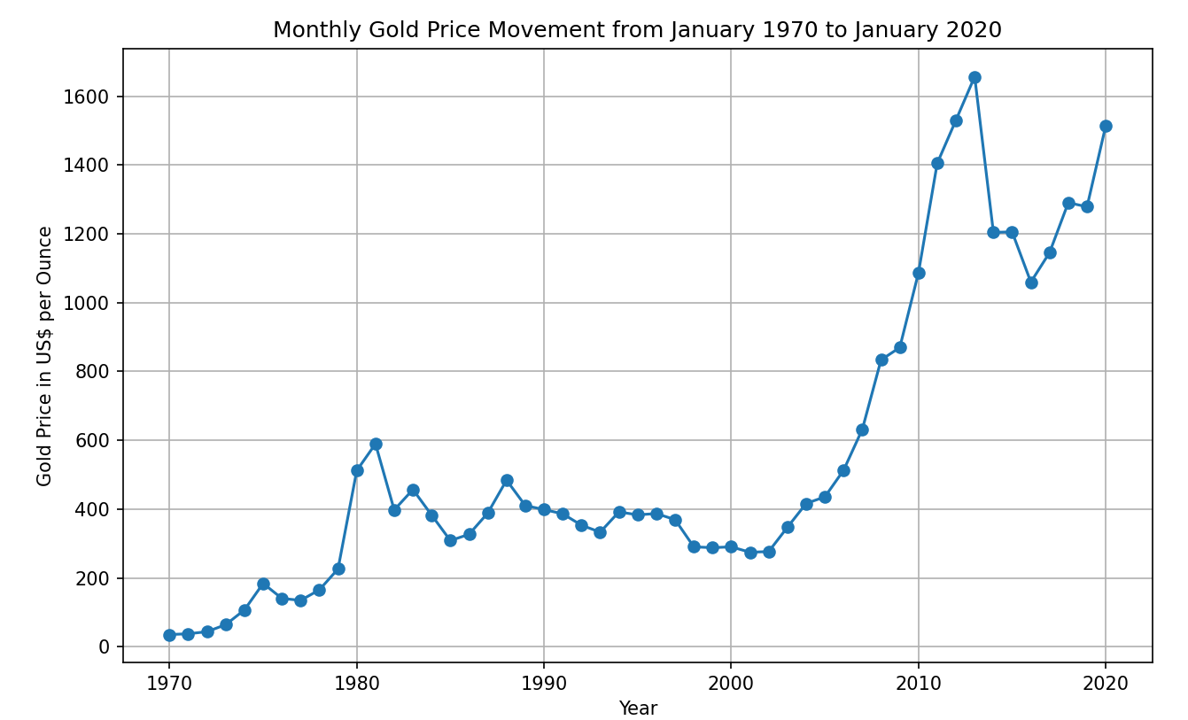
Visualizing a Time Series
C:\code\Data Analytics\time_series\gold_prices\ visualize_gold_prices_timeseries.py

Slide 5
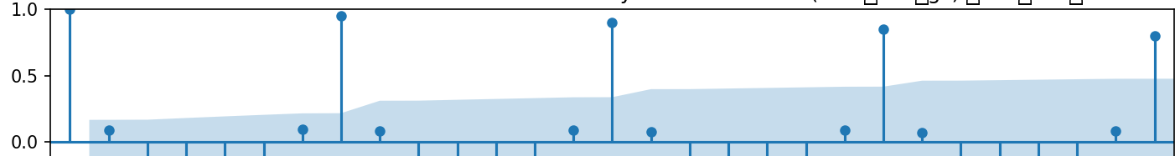
Seasonality and Autocorrelation
Example: A restaurant where people generally come only on Sundays
Plot the number of people visiting each day and try to find the correlation of day 0 (Sunday) with every next day for the next two weeks
Autocorrelation: Correlation with self (Correlation of Number of customers on Day 0 with Number of customers on each subsequent day)
restaurant_seasonality_example.py
High correlation every 7th day
Weekly cycle of seasonality

Slide 6
Moving Average
Problem: Data fluctuations are very high in the short term
Reason: Seasonality/Cyclicality
Example: Look at yearly_gold_prices.csv
Solution: Smoothen data
How?: Compute averages from overlapping groups of successive values in a time series
Called: Moving Average (MA) (See next slide)
Code: moving_average_gold_prices_timeseries.py (Note: The initial few rows will be blank for the moving total and average columns)

Slide 7
Moving Average Concept
Timeline | Gold Price | 3 Years Moving Total | 3 Years Moving Average | Short Term Fluctuation (3 Years MA – Gold Price)
Jan 1970 | 35.2 | … | … | …
Jan 1971 | 37.4 | … | … | …
Jan 1972 | 43.5 | 35.2 + 37.4 + 43.5 = 116.1 | 116.1 / 3 = 38.7 | 4.80
Jan 1973 | 63.9 | 37.4 + 43.5 + 63.9 = 144.8 | 144.8 / 3 = 48.2 | 15.63
Jan 1974 | 106.7 | 43.5 + 63.9 + 106.7 = 214.1 | 214.1 / 3 = 71.3 | 35.33
Jan 1975 | 183.9 | 63.9 + 106.7 + 183.9 = 354.5 | 354.5 / 3 = 118.1 | 65.73
Jan 1976 | 140.3 | 106.7 + 183.9 + 140.3 = 430.90 | 430.9 / 3 = 143.6 | -3.33

Slide 8
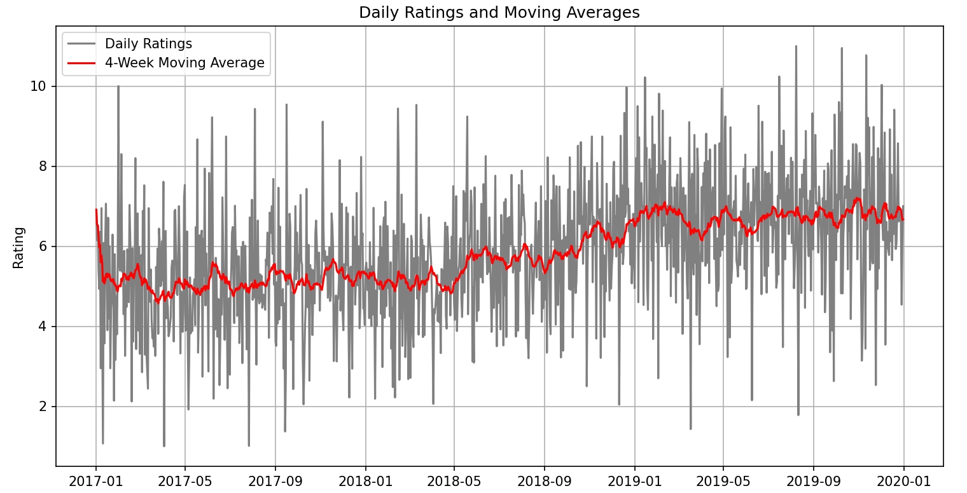
Moving Average – Another Example
C:\code\Data Analytics\time_series\gold_prices \Moving_Average_Concept_Customer_Ratings.py

Slide 9
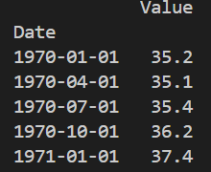
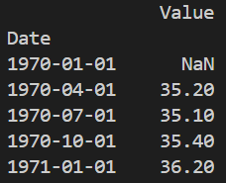
Lag (Time Shift)
Need: Predict future values using past values
How: Pandas has a shift() function, which allows us to shift data
Example: shift(1) will push data downward by one row
Lag: Now subtract current month’s value - shifted by one month value
Use: We can use predict price at time t using the price at time t-1
Code: shift_concept_gold_prices_timeseries.py
shift(1)

Slide 10
Stationarity and Seasonality
Stationarity: A time series is stationary if its statistical properties such as mean and standard deviation remain constant over time
Seasonality: A recurring pattern within a time series (e.g. daily/weekly/monthly etc)
Importance: If a time series showing these characteristics, we must consider them
Check: seasonality_stationarity_gold_prices_timeseries.py
If not: Will lead to incorrect forecasting
How? Differencing (Removing non-stationary trends), SARIMA (Handle seasonality)

Slide 11
Differencing
Date | Value | Differenced
Jan 1970 | 35.2 | …
Jan 1971 | 37.4 | …
Jan 1972 | 43.5 | 8.29 (43.5 – 35.2)
Jan 1973 | 63.9 | 26.5
Jan 1974 | 106.7 | 63.2
Jan 1975 | 183.9 | 120.0
Jan 1976 | 140.3 | 33.60
Jan 1977 | 134.5 | -49.40
Differencing: Helps in making time series stationary
How: Do not use the original values, but use values that have a difference of say 2*
Trial and error needed

Slide 12
ARIMA
Autoregressive Integrated Moving Average (ARIMA): Statistical model for forecasting time series data
Autoregressive (AR): Past values -> Future values
Integrated (I): Differencing used to make data stationary
Moving Average (MA): Incorporate past errors (Predicted - Actual) into future predictions
How to decide AR and MA values? PACF and ACF … To be discussed
Important: Works only on stationary data
Code: arima_gold_prices_timeseries.py
Drawback: Does not consider seasonal fluctuations, so predictions may not be good … Solution: SARIMAX

Slide 13
SARIMAX
SARIMAX: Seasonal Autoregressive Integrated Moving Average with exogenous regressors = ARIMA + Seasonality + Exogenous variables
Exogenous regressors: Components that may have external influence (e.g. gold price may be impacted by inflation)
Generally provides better estimates than ARIMA
Code: sarimax_gold_prices_timeseries.py

Slide 14
Time Series Analysis Example

Slide 15
Creating a Time Series
First run C:\code\Data Analytics\implementation\time_series\1_load_data.py
This loads the airlines data set, formats date, and makes it an index column
C:\code\Data Analytics\implementation\time_series\2_visualize.py
Shows a line plot of date versus passenger count
Shows patterns of up and down
There are four types of time series patterns (See next slide)
Trend: Dependent variable value increases or decreases over time (e.g. cumulative runs scored by a batsman in his career – will always show an increasing value)
Seasonal: Goes up in certain times (e.g. high sales during Christmas and year end)
Cyclic: Will go up for a time (not fixed), then go down for a time (not fixed) (e.g. boom and bust in financial markets) – Needs to be checked using the ACF plot (TBD later)
Irregular: No pattern

Slide 16
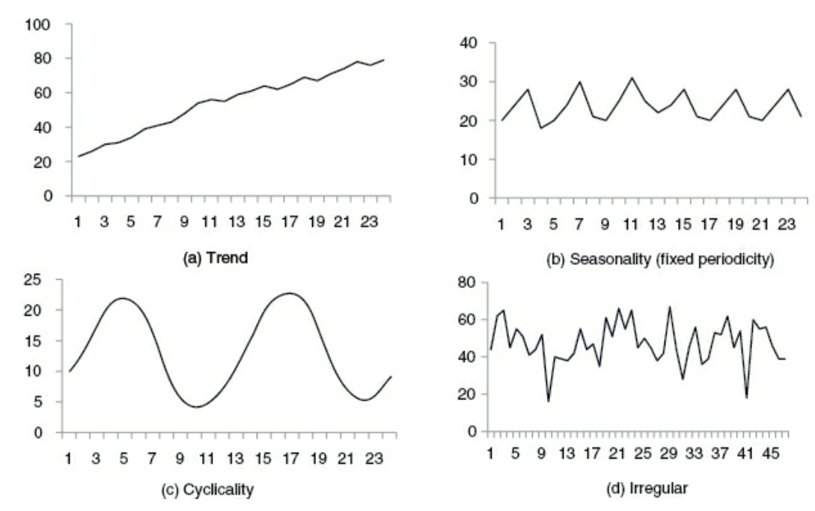
Time Series Components

Slide 17
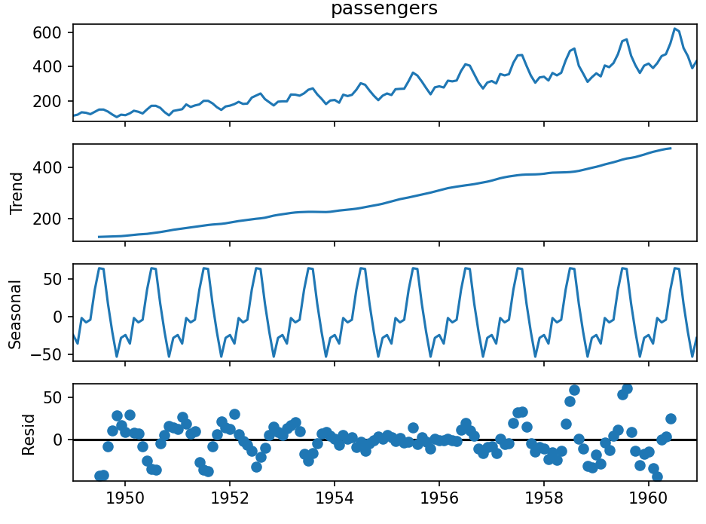
What We See In the Output Plot
Observed: Original data
Trend: Long-term movement
Seasonal: Repeating pattern
Residual: Noise/irregularities after removing trend and seasonality
Note: To see cyclicality, we need ADF (TBD)

Slide 18
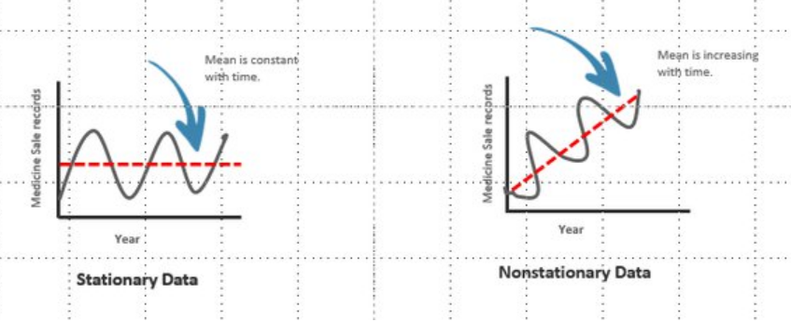
Creating a Time Series – Stationary Time Series
C:\code\Data Analytics\implementation\time_series\3_Check_stationary.py
Before doing time series analysis, we need to check if data is stationary
Stationary time series is one whose properties do not depend on the time at which the series is observed (e.g. patterns, seasonality), so remove trend and seasonality components from the time series
In such a series, the mean and standard deviation do not vary over time

Slide 19
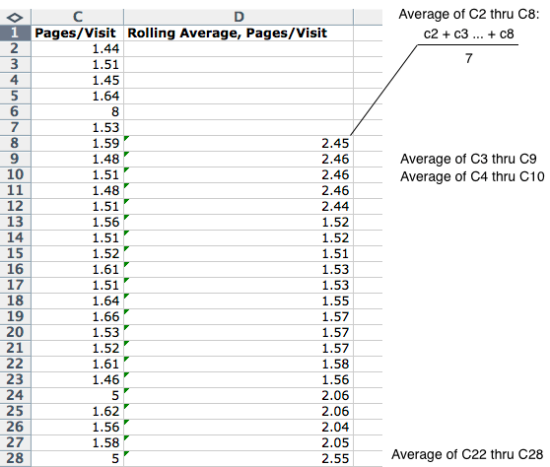
Creating a Time Series – Checking Stationarity
Note: Normally, if test statistic > critical value, we reject H₀ but in ADF, it is the opposite because of the mathematics behind it (calculating unit root etc), beyond our current scope
Augmented Dickey-Fuller Test (ADF)
H₀ = The data is not stationary
If Test statistic < Critical value, reject H₀ (i.e. conclude that time series is stationary)
Rolling Statistics
Take the rolling mean, rolling standard division and plot them
Rolling mean = Moving average

Slide 20
Creating a Time Series – Make the Data Stationary
We can use any of the following methods, not in any sequence, and just stop after one of them works
Time shift: Simplest
Log
Square root, Cube root, …

Slide 21
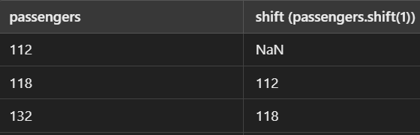
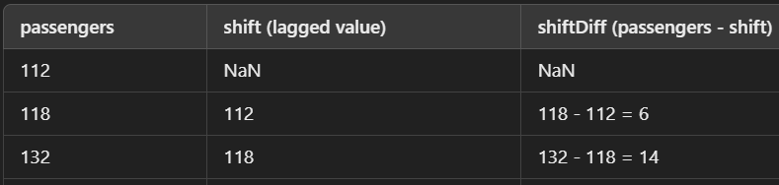
Creating a Time Series – Make Stationary – Time Shift
If a time series has trend (e.g. upward), values are consistently increasing … Differencing subtracts the previous value from the current value, thus flattening out the trend
C:\code\Data Analytics\implementation\time_series\4_Make_Stationary.py
air_df['shift'] = air_df.passengers.shift(1)
Purpose: Create a new time series that reflects changes in the data to identify and remove trends and then analyze seasonality/cyclicity
air_df['shiftDiff'] = air_df['passengers'] - air_df['shift']

Slide 22
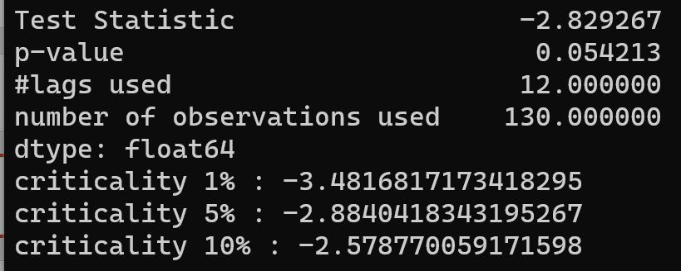
Creating a Time Series – Make Stationary – Time Shift - Results
Better than earlier
The data has become somewhat stationary
We will not try other make stationary techniques such as log, square root, cube root, etc

Slide 23
Creating a Time Series – ARIMA
Autoregressive Integrated Moving Average (ARIMA)
A statistical analysis model that uses time series data to either better understand the data set or to predict future trends
A statistical model is autoregressive if it predicts future values based on past values
Example: an ARIMA model might predict passenger count based on the past passenger count, or a stock’s future price based on the past prices
Useful for short-term predictions

Slide 24
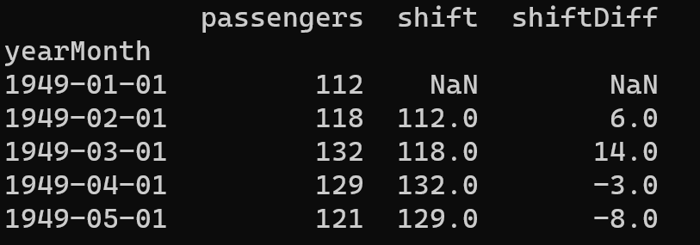
Creating a Time Series – ARIMA in Python
ARIMA (p, d, q)
Auto regressive p
Integrated d
Moving average q
p: How much in the past should we go? (Use PACF)
d: Number of differences to make the time series stationary
q: Number of unknown terms that multiply our forecast errors in the past (Use ACF)
Shift = d = 2

Slide 25
ACF
Auto Correlation Function (ACF) is a regression model that tells us about the correlation of y with its own lags, i.e.
Between y and lag₁y
Between y and lag₂y
Between y and lag₃y
…
Generally, we plot a graph showing lag on the x-axis and the correlation of today’s value with the lag value on the y-axis
Example: Next slide

Slide 26
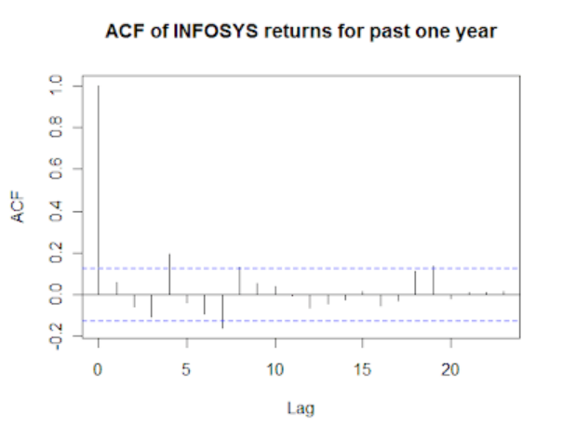
ACF
Today’s value compared with today’s value, so correlation is 100% or 1
Blue lines: 95% confidence interval lines
Values crossing the lines are significant, i.e. today’s return and that day’s return have a statistically significant relationship
Corelation of today’s price with yesterday’s price (Lag = 1)
Corelation of today’s price with price 2 days ago (Lag = 2)

Slide 27
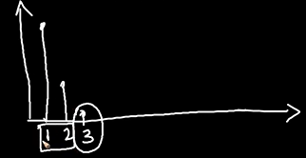
PACF
Partially Auto Correlation Function (PACF) is similar to ACF
Conveys the relationship of y with its lags, but after removing the effects of the intermediate lags
Example: Here, if we want to see relationship between y and lag₃y then it does so after removing the effects of lag₁y and lag₂y
Conveys the strength of lag₃y only

Slide 28
Creating a Time Series – SARIMAX
Seasonal Autoregressive Integrated Moving Average Exogenous model (SARIMAX)
Seasonality occurs when certain patterns are not consistent, but appear periodically
So, a simple autoregressive component would not describe that data well
Example: Low sale in November will result into a similar prediction for December (incorrect), but actual high sale in December will result into a similar prediction for January (also incorrect)
Here, SARIMAX comes into picture

Slide 29
ARIMA (p, d, q)
SARIMAX (p, d, q) (P, D, Q, s)
P, D, Q are seasonal equivalents of p, d, q
s is the length of the cycle
Example:
ARIMA (1, 1, 2)
p: Current month’s sales depends on the previous month’s sales (1)
d: We need to take one lag to make data stationary (1)
q: Consider the influence of one past forecast error (2)
SARIMAX (1, 1, 2) (1,1,1,12)
First three: Similar to ARIMA; then we have four more
P: Capturing the influence of the same month last year (1)
D: We need to take one seasonal lag to make data stationary (1)
Q: Consider the influence of one past seasonal forecast error (1)
s: Assume monthly data, considering yearly seasonality (12)
Also see c:\code\Data Analytics\implementation\arima_sarimax.py

